Slide 1

INTERNSHIP REVIEW(20CSE83A) Academic Year (2021-22) Computer vision beyond OCR
BY: NAME: BHARGAVI P USN: 1NH18CS735 SEM/SEC: 8Th/ D
Reviewer
Ms. Rachana Ma'am
Senior Associate Professor
Dept. of CSE, NHCE

Slide 2
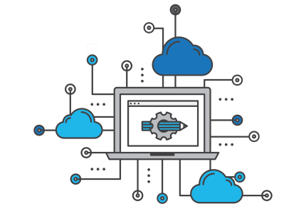
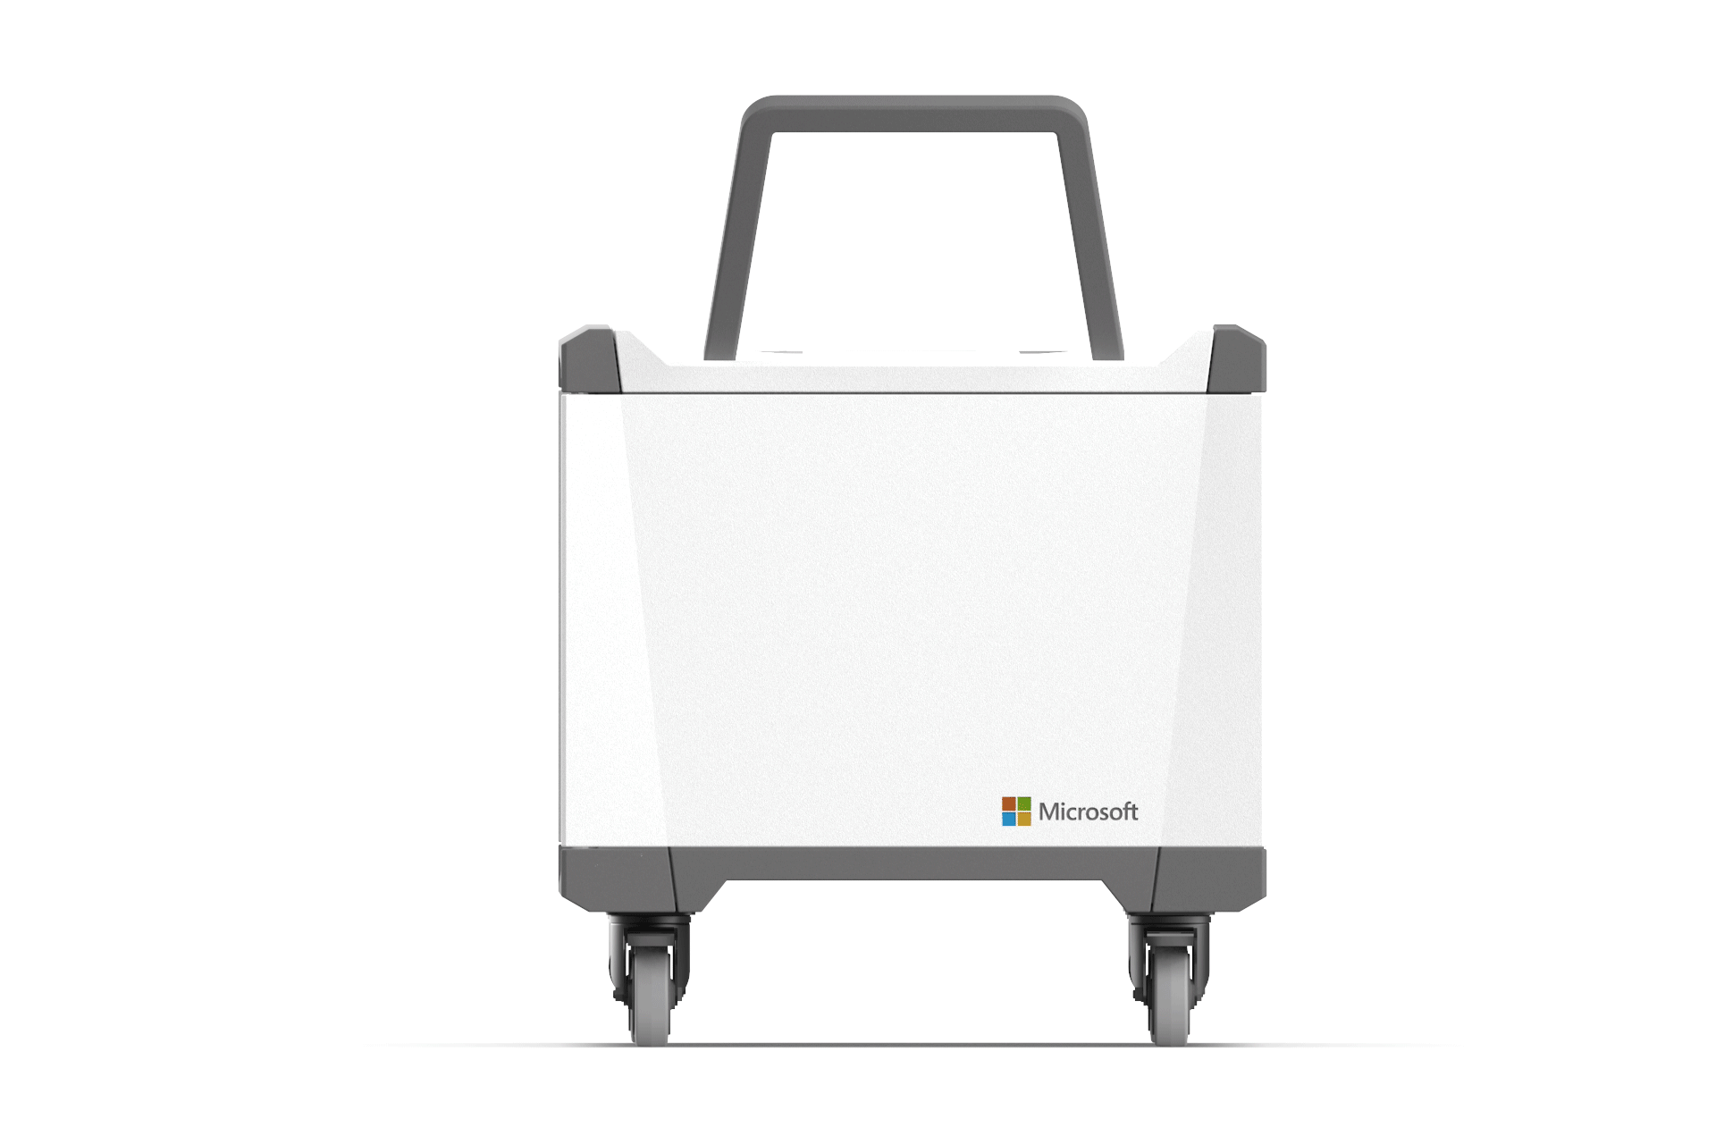

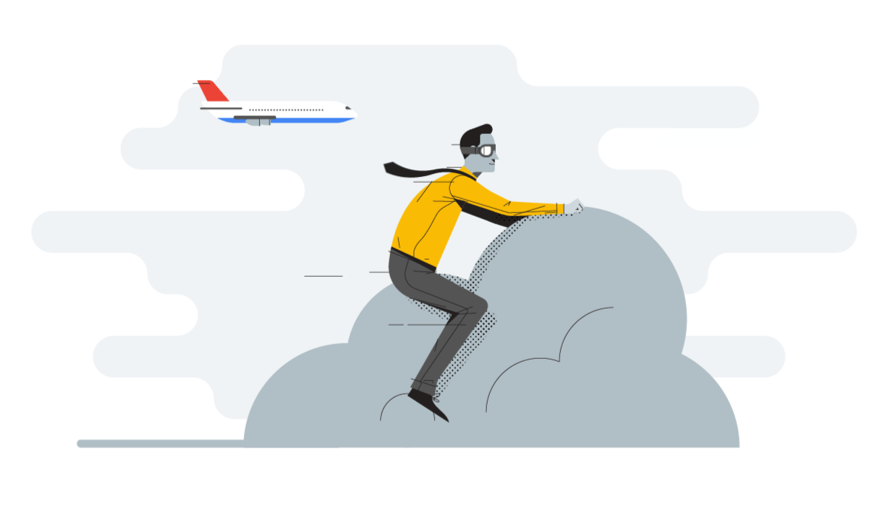
Computer vision beyond OCR

Slide 3
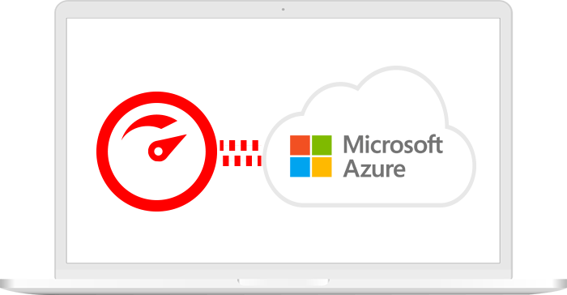
AGENDA
Introduction
About the Organization
Hardware and software Requirements
Technical takeaways
Output Screenshots
Conclusion
Future Work

Slide 4

Introduction
In day to day life as the technology is getting more advanced so the working way of organizations or business is getting more and more enhanced.
As an intern I am doing the internship in the domain of Cloud Computing where the data is stored in or over cloud and making use of it.
In the cloud we were working on the Technology called Microsoft Azure under cloud domain in which the receipts are been converted to text form(json) where we are training the models by giving few sample inputs like in the form of Documents(which includes logo inspection).
Notes:
Now, that you have narrowed your topic, you will want to organize your research in a structure that works. There are some common organizational patterns based on the kind of research you are doing.
Organizational Structures:
Cause and Effect- this kind of structure is great for explaining the causes and effects of a topic
Compare and Contrast- in this pattern you highlight the similarities and differences of the topic
Explain process- this structure is great for outlining a series of steps to follow;
Definition- if you want to make sure your audience understands what something is using illustrations, meanings, clarifying misconceptions, you may want to use this structure
Classification- a common organizational structure is grouping like topics or facts from the research together. For instance, in the internet safety about social media apps, you may organize the research where you look at each social media app one at a time

Slide 5

About the Organization
Name of the Company :- Rapsol Technologies Pvt. Ltd
Position :- Intern in Microsoft Cloud Azure
Description about Organization :- From Web design to elevation design, constructing websites to constructing buildings, we are a team of highly passionate professionals dedicated to deliver excellence, As our expertise is in multiple domains we even train both students and professionals in almost all the technologies. we are currently working on a application which helps the organizations in managing their day to day activities. We do trainings web design and development, react, java, python along with its frameworks , Mechanical, automobiles, aerospace, civil, architecture etc. We even provide career guidance for the students who are in confusion, Of course we are the best Training institute in Bangalore and also the best Website development company in Bangalore. As we also have another firm which is in to construction of buildings with the name KNS Contracts, so we can construct your dream homes too.
Notes:
When conducting research, it is easy to go to one source: Wikipedia. However, you need to include a variety of sources in your research. Consider the following sources:
Who can I interview to get more information on the topic?
Is the topic current and will it be relevant to my audience?
What articles, blogs, and magazines may have something related to my topic?
Is there a YouTube video on the topic? If so, what is it about?
What images can I find related to the topic?

Slide 6

Hardware and Software Requirements :
Software requirements Microsoft azure (as cloud provider),
Azure Form recognizer
Azure Form recognizer studio Storage accounts
Visual studio code
Hardware requirements RAM 4GB i3 processor and stable internet connection programming languages used python Operating System Window/Linux
Notes:
Once you find your sources, you will want to evaluate your sources using the following questions:
Author:
Who is the author?
Why should I believe what he or she has to say on the topic?
Is the author seen as an expert on the topic? How do you know?
Current:
How current is the information in the source?
When was the source published?
Is the information out-of-date?
Accuracy:
Is the content accurate?
Is the information presented objectively? Do they share the pros and cons?

Slide 7
Technical Takeaways :
exposure to cloud.
hands on experience with Azure Applied AI services such as Form recognizer and storage account (blob storage) .
working with real time use cases with python.
understanding of consuming rest API.
Extracting the data from the documents.
Working with real time use cases of data extraction.
Notes:
After consulting a variety of sources, you will need to narrow your topic. For example, the topic of internet safety is huge, but you could narrow that topic to include internet safety in regards to social media apps that teenagers are using heavily. A topic like that is more specific and will be relevant to your peers. Some questions to think about to help you narrow your topic:
What topics of the research interest me the most?
What topics of the research will interest my audience the most?
What topics will the audience find more engaging? Shocking? Inspiring?

Slide 8

Conclusion :
This internship has been an excellent and rewarding experience. I can conclude that there have been a lot I have learnt from my work Rapsol Technologies. Needless to say , the technical aspects of the work I have done are not flawless and could be improved in provided enough time. In this work we have learnt how to extract data from the documents in an easy way. By storing the similar documents as sample documents we can extract the lakhs of documents which are similar to sample documents. Form recognizer is used to recognize the form samples and mark each field as text, logo etc. so we can extract lakhs of documents data in a simple way. We can do this process in two ways.
1) we can do this process by using azure tools and form recognizer tools.
2) We can also do this process by developing the code. In future we can extract all the types of data from the documents. And we can upload any type of languages to recognize and extract data.
Notes:
After you’ve done your research, it’s time to put your presentation together. The first step in the process is to introduce the topic. This is a great time to connect your topic to something that your audience can relate. In other words, why should they listen to all the information you will be sharing in your research presentation? What is in it for them? You may also want to include a graphic or image to grab their attention.
Feel free to duplicate this slide by right-clicking on this slide in the slides pane to the left and select Duplicate Slide.
The next step in your presentation is to state your claim or topic clearly. Your teacher may even call this your thesis. As you state your thesis, you may find that this layout is not the best layout for your claim or topic. You can change the layout by clicking the drop-down menu next to the Layout in the Slides menu section. You can choose Two Content, Comparison, or Picture with Caption. Note: A different layout might change the look of the icons on this page.
You will also want to state your facts. You have done the research now share some of the interesting facts with your audience. Facts do not have to be boring; you can communicate facts in a variety of ways by going to the Insert Tab. In the Insert tab you can:
Insert pictures from your computer or online.
Add a chart
Create some SmartArt
Insert a variety of icons to help your facts come to life. Note: You can change the color of the icons by selecting the icon and then click on the Format tab and then Graphics Fill. From there, you will choose a color from the list or choose More Fill Colors to give you more options.
Since this research presentation is a result of your hard work and searching, you want to make sure you support the claims or points in your presentation with facts from your research findings. Make sure you give the author proper credit for helping you share your ideas. If one of your sources has a video that is relevant to your topic, you can add the video as added support. Keep in mind the length of the video and the amount of time you have for your presentation. For a 5 minute speech, the video should be no longer than 30 seconds.
Questions to consider:
How will you state the author of the source?
Will you need to cite the source on the slide?
What are some ways you can engage your audience so they feel like they are a part of the presentation? Some ideas to consider is by taking a quick poll like: by a show of hands, how many of you think school uniforms are a way to cut down on bullying? Another suggestion is to have them hold up a certain number of fingers to see if they agree or disagree. Finally, you can share a story that the audience can relate to that makes them laugh.
After all the applause, your audience may have some questions. Be prepared to answer some of their questions by making a list of questions you think they might ask. You may also want to share the presentation with them by providing the link to your presentation, if they want more information.

Slide 9
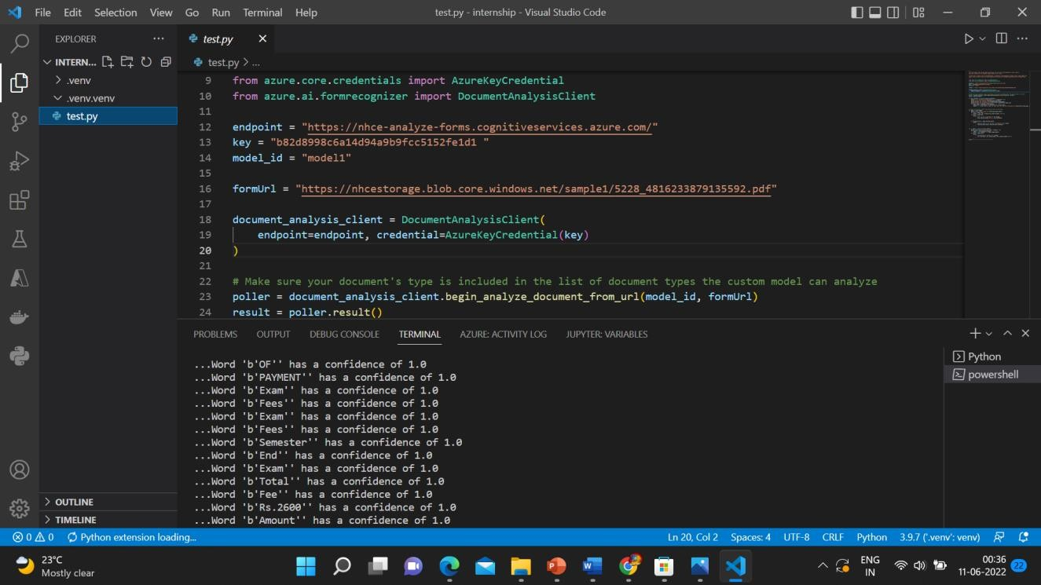
Outputs:
MAIN OUTPUT – 01

Slide 10
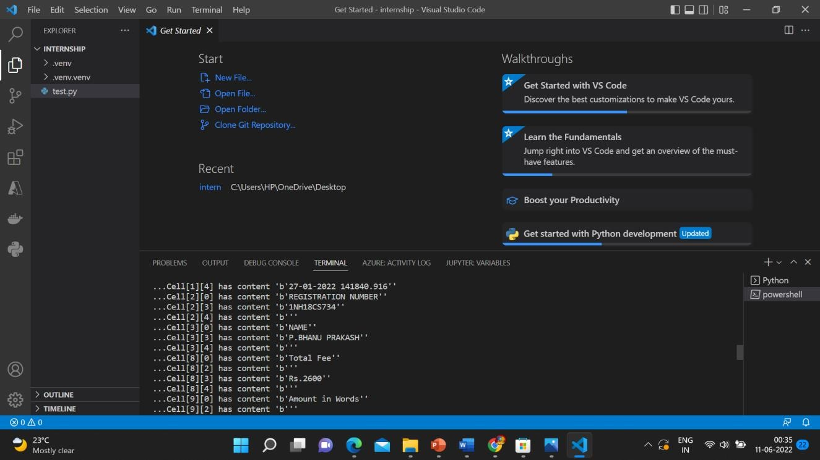
MAIN OUTPUT - 02

Slide 11
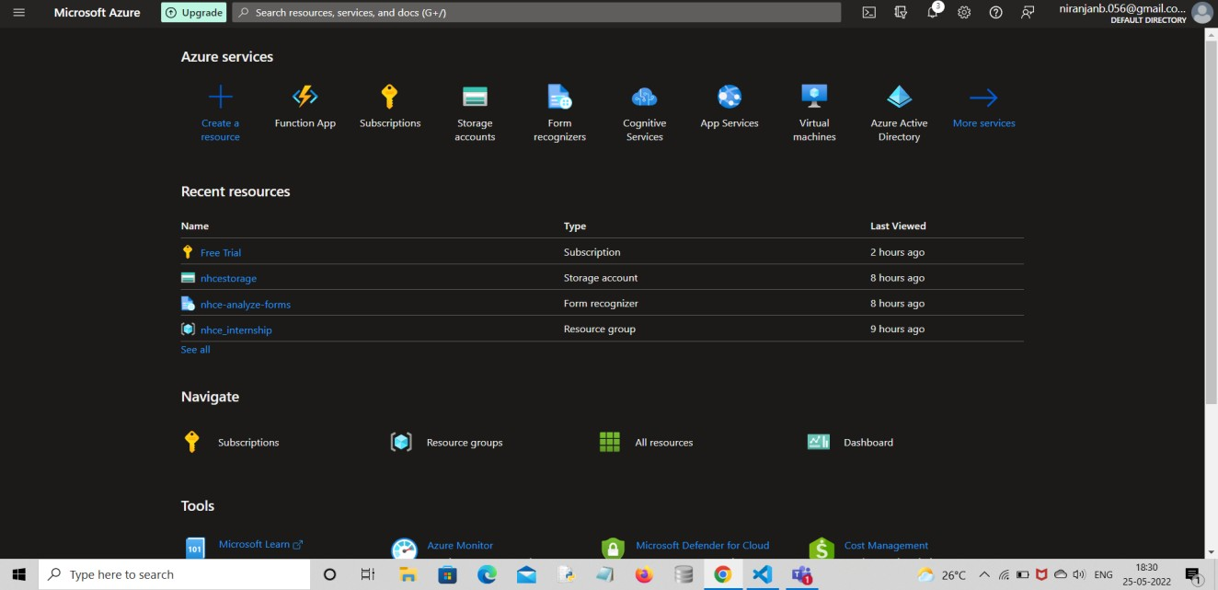
MAIN PAGE

Slide 12
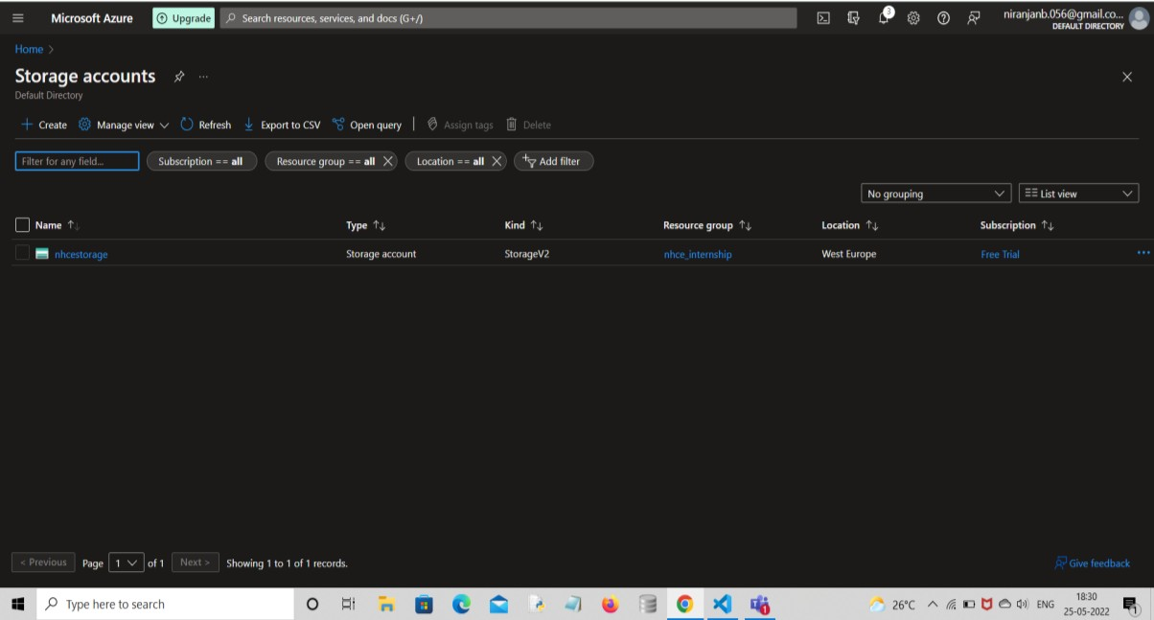
STORAGE ACCOUNT

Slide 13
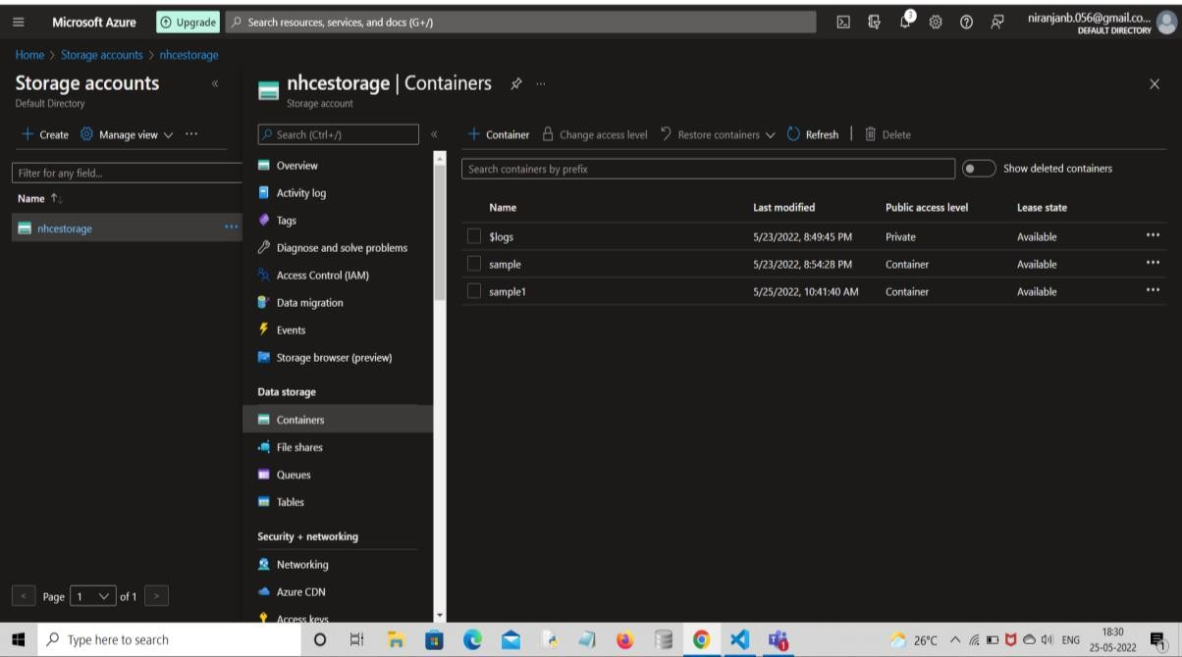
CONTAINERS

Slide 14
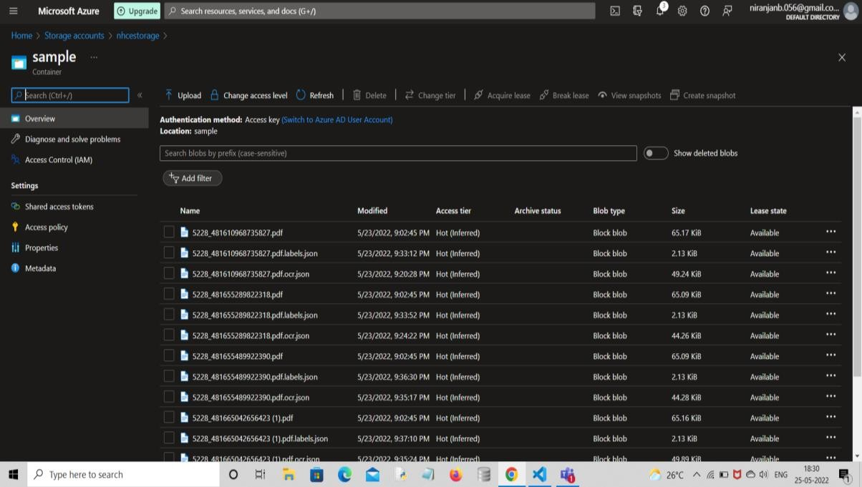
SAMPLE MODULES

Slide 15
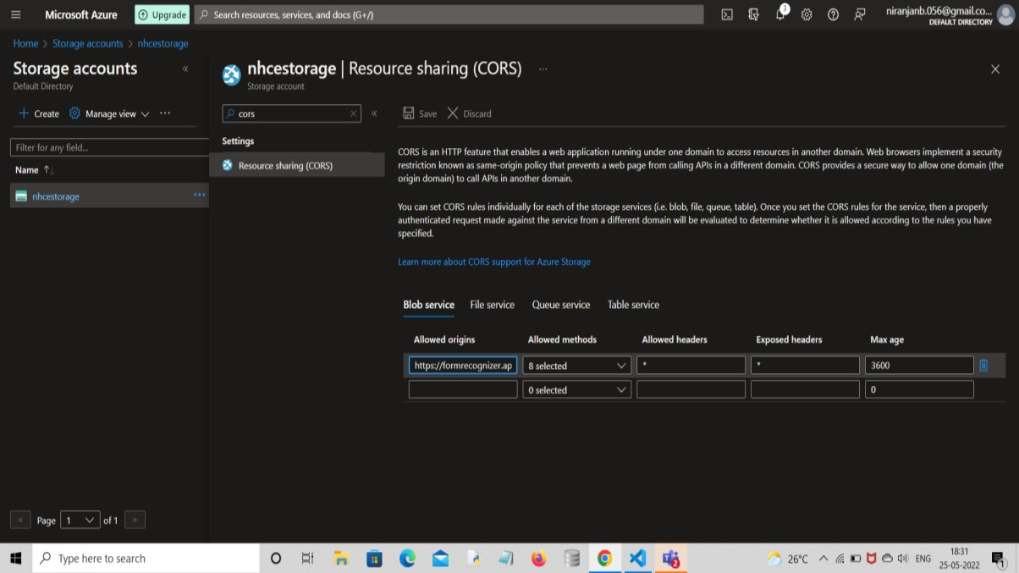
FORM RECOGNIZER CONNECTOR

Slide 16
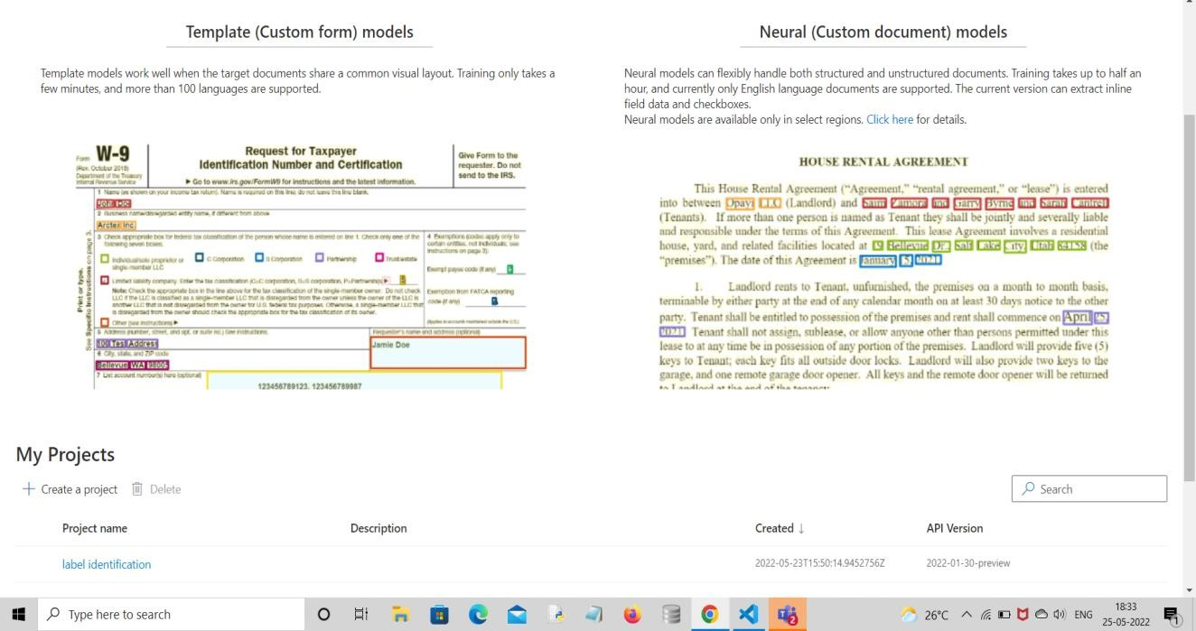
FORM RECOGNIZER STUDIO

Slide 17
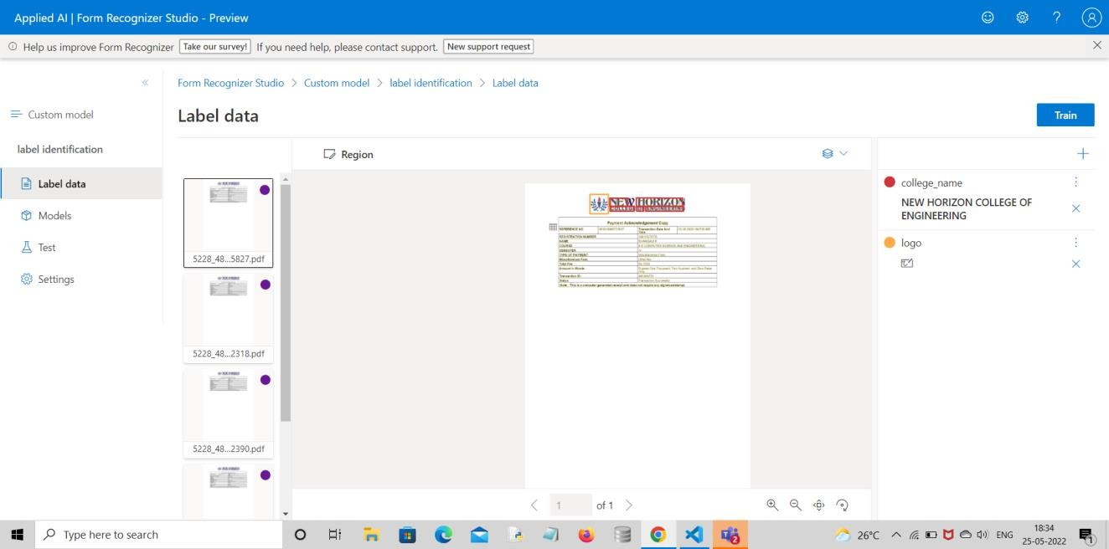
LABELING DATA

Slide 18
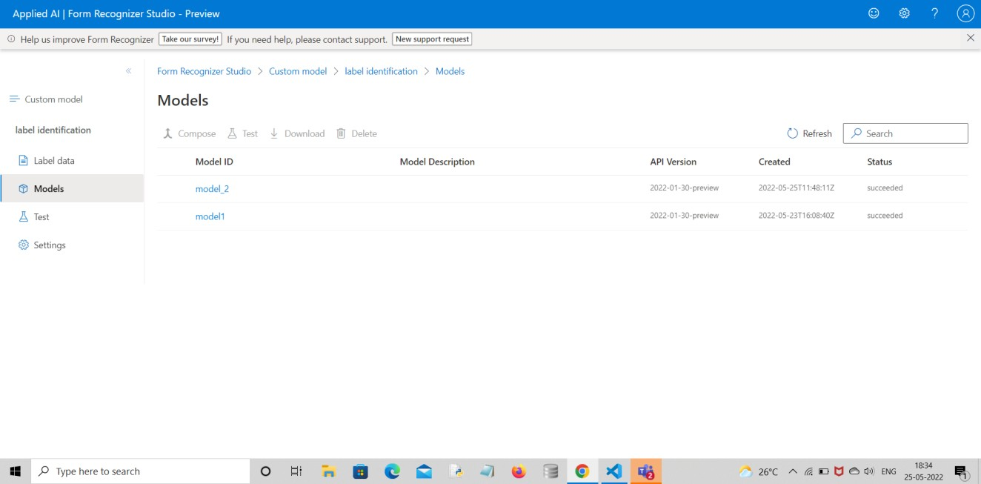
MODELS

Slide 19
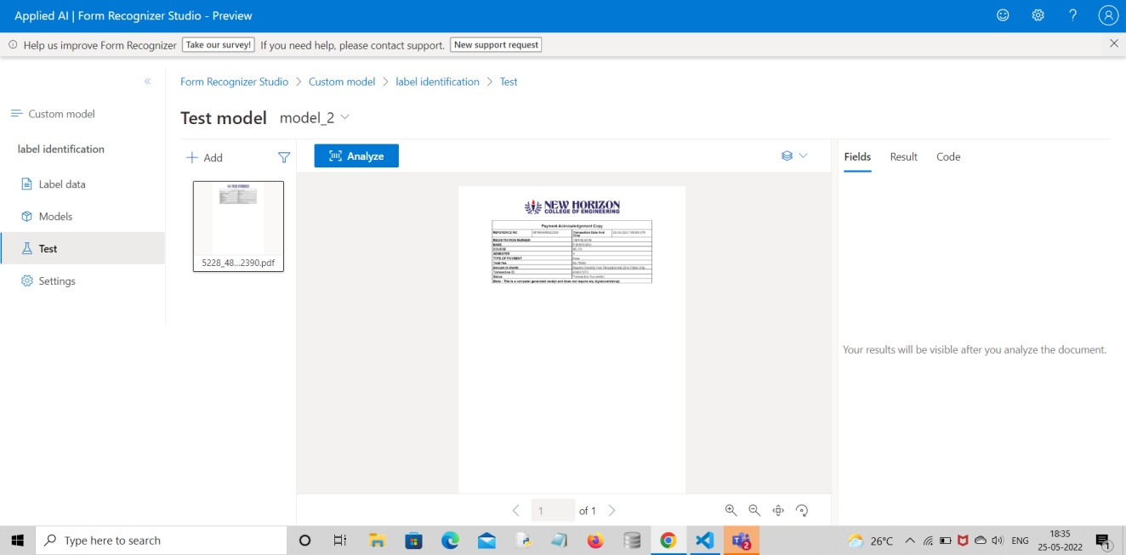
TEST MODEL

Slide 20
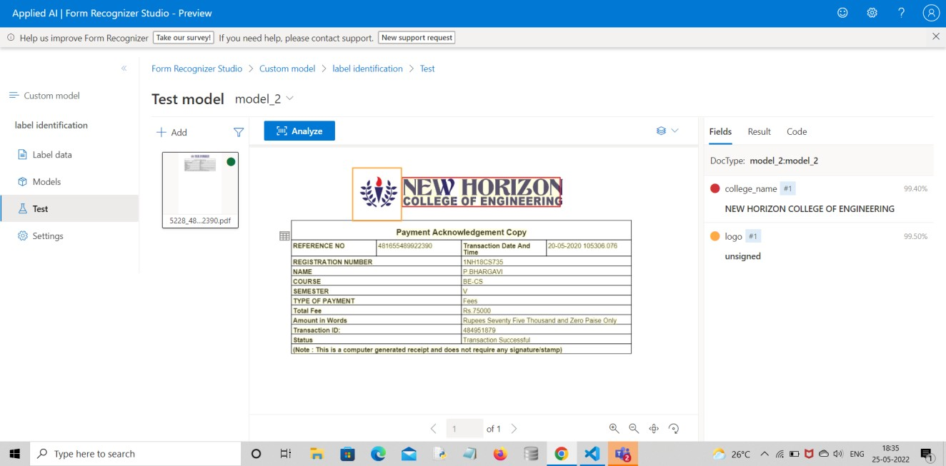
RESULT

Slide 21

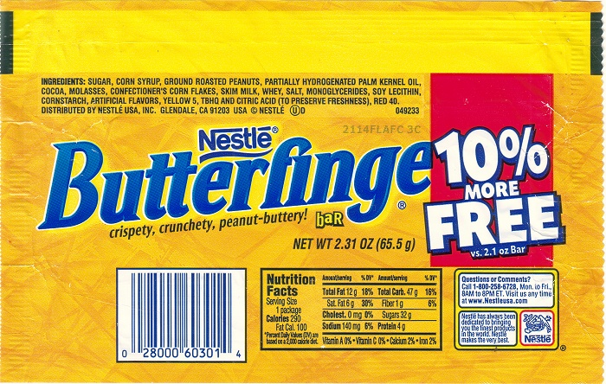
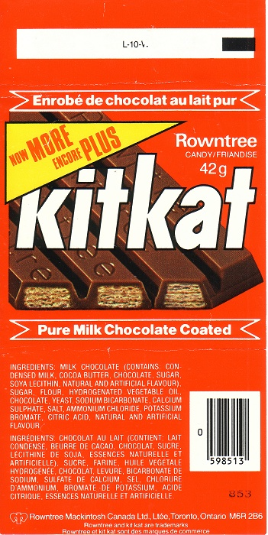
Future work :
In the future Work We can add any languages so the for recognizers automatically should recognize the language and extract the data from the document what we have uploaded or stored in the storage.
In the future work we can also add barcodes, QRcodes so the form recognizer should extract the barcodes or QRcodes from the document or any Product Wrapper.
So this Process is used to extract large amount of similar data at a time from the given documents.
It also shows the accuracy of the document compared to sample documents.

Slide 22


